Slide 1
C# experiences
Soheil Ramezanzadeh Lamso
soheillamso@gmail.com
June 2023

Slide 2

PERSONAL PROFILE
Hamed Kalantari
Live in Tehran
33 years old
ACHIEVEMENTS
WORK EXPERIENCE
Successful developing and execution of 4 software projects
Nwms/ibaar/ibaarpay/bolIbaar
Degree of brilliant talent in the bachelor's degree
Honors student in master's degree
9 years work experience in Business as a:
C# Full Stack Developer
Product Manager and Project Manager
Software Analyst
Technical SKILLS
About Me
EDUCATION
C#
Sql Server/ postgres Sql
Angular
Windows Server/Ubuntu
UML/BPMN/BPMS
Scrum
Master in IT Engineering
Iran University of Science and Technology
Work Interests
HOBBIES
CONTACT INFO
C# .NET Core Web Api Developing
Analysis and design of the front side
Playing with my son
Volleyball
Reading poetry
Phone: +989362948894
Email: soheillamso@gmail.com

Slide 3

Work Experience
1

Slide 4
Project 1:
Goods storage system
https://www.nwms.ir
Developing C# WinForm For Testing Soap Web Service
Developing C# WCF services
Developing C# Windows Service: Calling Soap & Rest inside
.net framework/Sql Server/ Sqlite

Slide 5
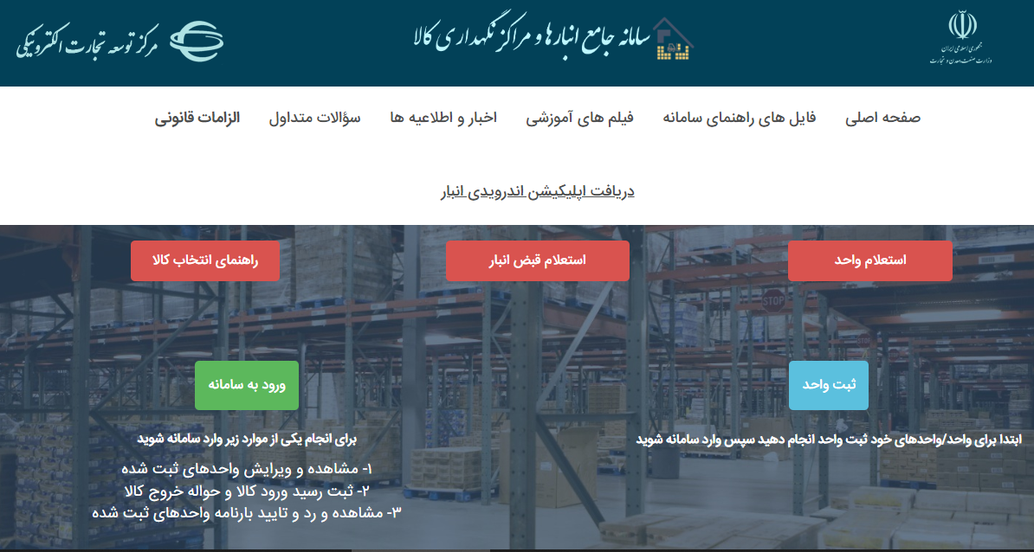
https://www.nwms.ir

Slide 6
Project 2:
Truck fuel allocation software
Developing C# WinForm
By controlling the license on the authorized computer
.net framework/ Sqlite

Slide 7
Project 3:
Ibaar BI
https://bi.ibaar.ir
Backend: Developing C# .Net Core Web Api
Authentication/ Authorization
Front: Developing Angular SPA
Db: Sql server
Server: windows IIS/ubuntu nginx

Slide 8
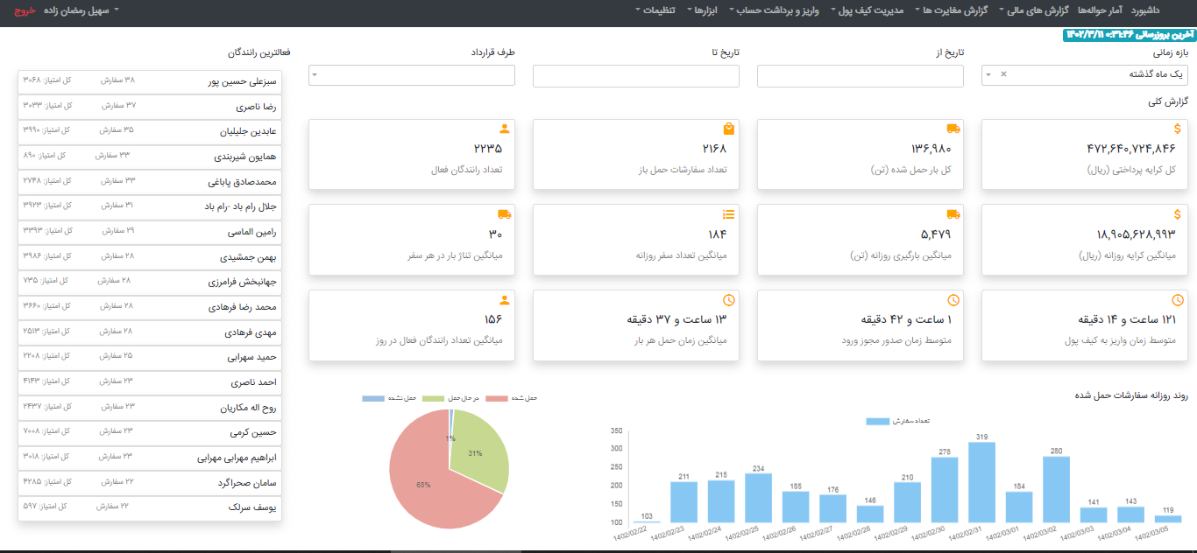
https://bi.ibaar.ir

Slide 9
Project 4:
BOL Ibaar
https://bar24.ibaar.ir
Backend: Developing C# .Net Core Web Api
Front: Developing Angular SPA
Db: Postgres Sql
Server: windows IIS/ubuntu nginx

Slide 10
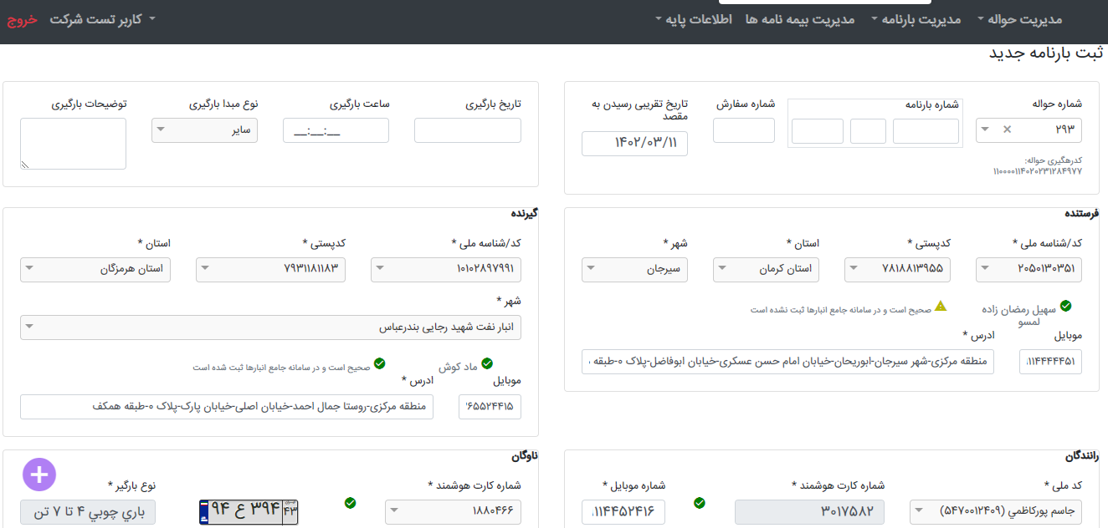
https://bar24.ibaar.ir

Slide 11
Other windows applications
Eyeglass store application: C# WinForm/sqlite
Capital management application : C# WCF/WinForm/Sql Server
Ability to update over FTP
.net framework

Slide 12
Other Web applications
Investment plan management system: C# .Net Core Web Api/ Angular
Capital management application : Angular

Slide 13
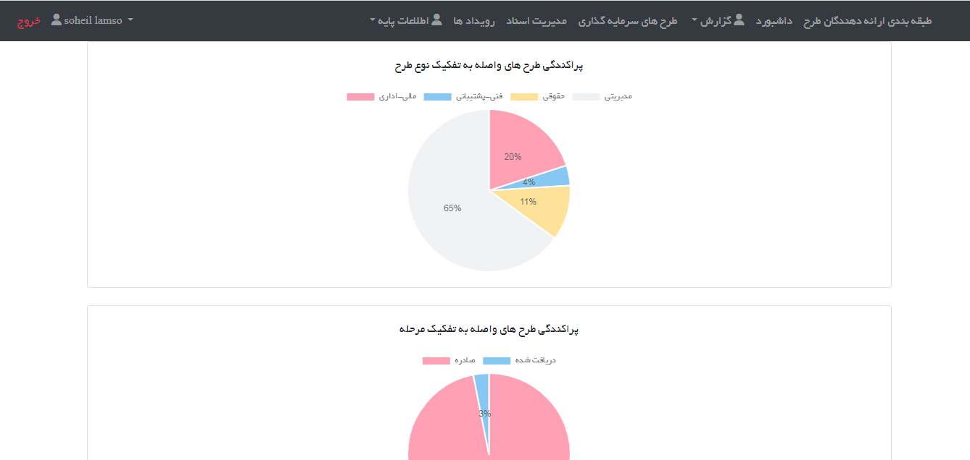
https://track.ibaar.ir

Slide 14
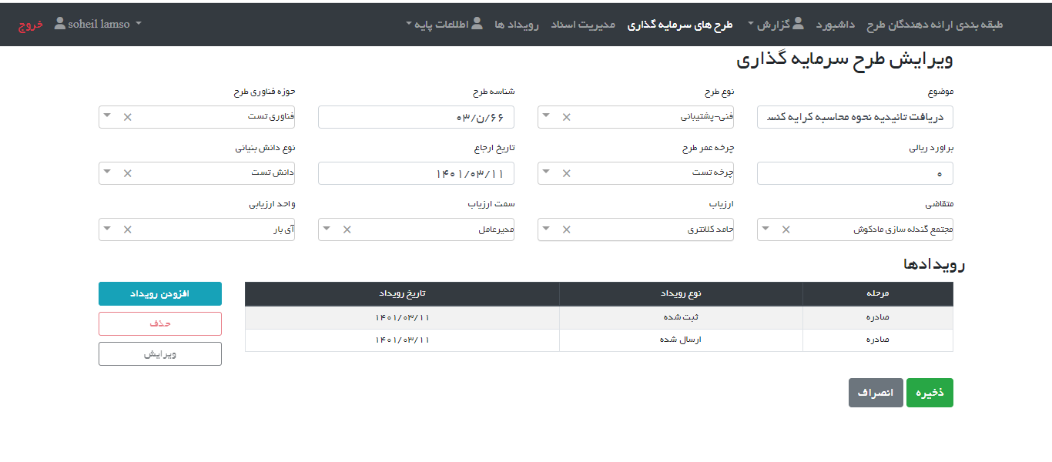
https://track.ibaar.ir

Slide 15
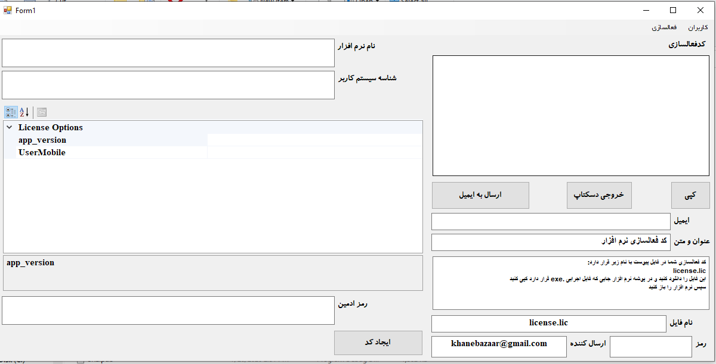
License Activator

Slide 16
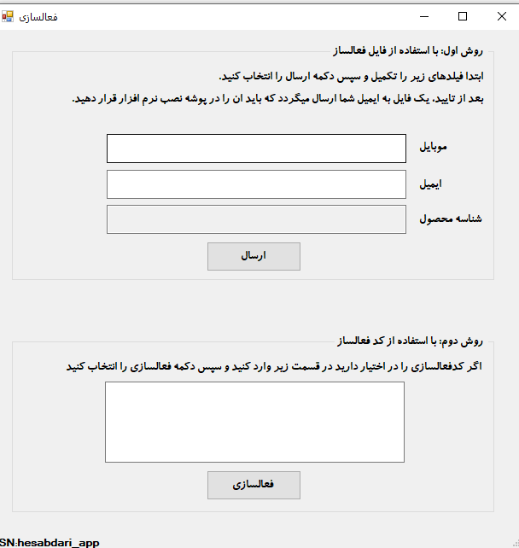
License Activator

Slide 17
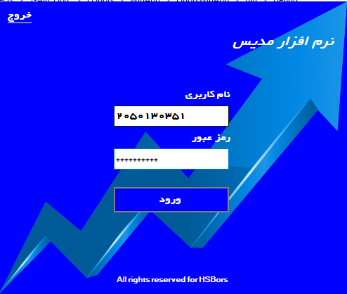
My WinForm Login Sample

Slide 18
Other Skills
Etl/Data Integration/ Pentaho Spoon/Cube
Jmeter
Git

Slide 19
Salary Expectations
2
between £5 and £10 an hour

Slide 20
Daily Time Availability
3
15 hours per week
2 to 3 hours a day

Slide 21
The End

